Slide 1

New Jersey Department of Education
Elementary and Secondary School Emergency Relief (ESSER) Roundtable Series:
Teacher Shortage
Division of Educational Services
April 27, 2022
Notes:
Anthony

Slide 2
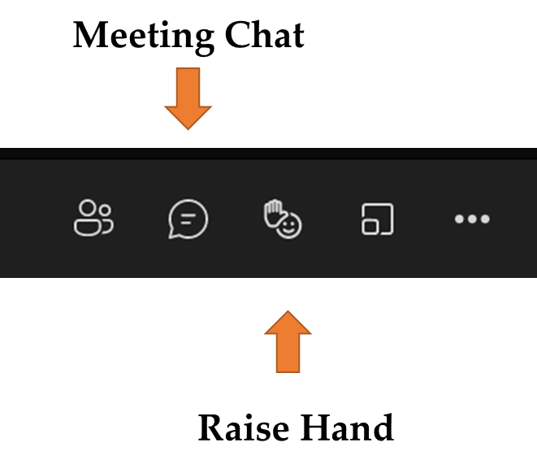
Using Microsoft Teams
  Chat
    We welcome your participation in discussions by asking questions and adding comments in the chat box.
  Raise Hand
  Please use the raise hand feature if you want to speak.
  Mute/Unmute
    Please remain muted whenever you are not speaking.
Notes:
Peggy

Slide 3
Agenda
Housekeeping Dr. A. Charles Wright, Executive Director/Deputy Assistant Commissioner Division of Educational Services
Welcome Ms. Kathy Ehling, Assistant Commissioner, Division of Educational Services
Teacher Shortage Ms. Tanisha Davis, Director Office of Recruitment, Preparation and Certification
North Arlington Public School District
Princeton Public School District
Cinnaminson Public School District
Notes:
Anthony

Slide 4
Welcome
Notes:
Kathy
The next few slides review the allowable uses of the ESSER funds.
Next slide

Slide 5
Addressing Teacher Shortage
Notes:
Next slide

Slide 6
Identifying Educator Shortages
Supply, demand and composition
Percentage of teachers out of field
Student enrollment data
Projected retirements
Retention rates
Number of new certificates issued
Hire rate of newly certified educators
Number of emergency certificates issued

Slide 7
Addressing Educator Shortages
Substitute credential flexibility
Limited CE/CEAS five-year pilot program
Retired educators re-entering workforce
Expanded accreditation definition
Expedited certification process for employed applicants
Emergency educational services certification
Minority Teacher Development Grant
Minority Teacher Quality and Retention Grant
Men of Color Hope Achievers (Partnership w/ Rowan University)

Slide 8
District Strategies
Collaborate with educator preparation programs at colleges/universities
Host clinical interns (student teachers)
Paid residencies
Recruit career changers through alternate route
Grow your own programs
Limited CE/CEAS Pilot Program
Certification guidance and support

Slide 9
North Arlington Public Schools
Notes:
Anthony

Slide 10
NORTH ARLINGTON PUBLIC SCHOOLS
Superintendent of Schools: Dr. Stephen Yurchak
School Business Administrator: Mrs. Samantha Dembowski
Director of Curriculum & Instruction: Mrs. Samantha Rodriguez-Torrento

Slide 11
SHARED GOAL
To develop, implement, and continuously refine data-driven remediation and intervention programming that addresses learning loss and fosters learning acceleration.

Slide 12




PROGRAM COMPONENTS
Summer Learning Academy Staff & PD (CARES I)
Extended instructional support Staff & PD (ESSER II)
Instructional Materials and Programs:
LinkIt!
Gr 1-12
Assessment Platform
NJSLS-based Benchmarks & Released Items
Data Locker
Detailed Subgroup Reports
IXL
Gr K-12
Scaffolded Questions
NJSLS-based
Analytics & Diagnostics
Game-Based Features
Lumos Learning
Gr 3-12
State Assessment Rehearsal
Analytics & Diagnostics
Digital & Consumable
NJSLA/S-based
Sadlier
Gr K-2
Digital & Consumable
NJSLS-based
Early Ed. Driven

Slide 13
2021- 2022 TIMELINE
At-Risk Students were identified and recomended for Summer Learning Academy (SLA).
SLA is over. Summer Reading & IXL Independent Practice. District Start Strong Prep.
LinkIt! Form A assesses grade-level readiness. Data is compared with S.S. data. *Single Point Rubrics (SPR) introduced.
Families are notified of EIS recommendation. Rosters are developed. Teacher PD takes place and diagnostics are disseminated.
LinkIt Form B.
SPR/ Data Meetings take place for spring targets in the classroom. EIS Spring recs are shared .
EIS ends before week one of NJSLA.
JUN
JULY
AUG
SEP
OCT
NOV
DEC
JAN
FEB
MAR
APR
MAY
Teachers received PD and diagnostic data for each student recommended for SLA.
Start Strong data is analyzed and shared with all buildings. Custom overview report also shared.
Extended Instructional Support (EIS) rosters are developed into 2 tiers. EIS posting goes out to all staff.
EIS is in full swing. Feedback from teachers and students is evaluated.
EIS Spring with adoption of Lumos and Sadlier Programs.
Form C data will measure efficacy and drive SLA recommendations
*Single Point Rubrics (SRPs) have been progressively introduced to staff during PLC and data articulation sessions to bridge gaps between targeted before/after school programming and in-class goals. SRPs are based on focused targets to foster mastery over pace.
13

Slide 14
DIAGNOSTIC DATA
STUDENT OVERVIEW
LEVEL OF PROFICIENCY
Name, grade, contacts,
subgroup, and/or program with special considerations related to instruction.
Students identified as At-Risk & Bubble to indicate intervention
or remediation placement
WEAKNESSES & STRENGTHS
QUESTION TYPES
Student mastery/ deficiency by individual NJSLS tied to grade-
level proficiency in the areas of Math and/or ELA
Student mastery/ deficiency by content area skill (i.e. analyzing informational texts) and
question type (i.e. drag and drop)

Slide 15
EVALUATING EFFICACY
Summer Learning Academy Approx. 100 Students:
  80% of all ELA/ELL Summer Academy students who took LinkIt! Form A were no longer in
  danger of "Not Meeting" grade-level standards and achieved "Partially Meeting" scores
  or higher after taking the LinkIt! Form A assessment of this year's NJSLS.
  86% of all Math Summer Academy students who took LinkIt! Form A were no longer in danger of "Not Meeting" grade-level standards and have achieved "Partially Meeting" scores or higher after taking the LinkIt! Form A assessment of this year's NJSLS.
EIS Fall Enrollment Approx. 290 Students:
  Fall EIS Remediation students showed 15% Avg. Growth from LinkIt! Form A to Form B.
  Fall EIS Intervention students showed 30% Avg. Growth from LinkIt! Form A to Form B.
  Over 80% of all students showed growth from LinkIt! Form A to Form B

Slide 16
HEARING FROM STUDENTS
75% of elementary students reported feeling more confident in their abilities during their regular classes after attending EIS.
98% of elementary students feel like their skills have improved after attending EIS.
95% of elementary students would recommend EIS to other students who are struggling.
96% of secondary students feel like their skills have improved after attending EIS.
86% of secondary students reported feelings more confident in their abilities after attending EIS.
100% of secondary students would recommend EIS to other students who are struggling.
16

Slide 17
BRIDGING GAPS BETWEEN EXTENDED PROGRAMMING & THE EVERYDAY CLASSROOM
Specific programs carry over student achievement data and differentiated practice:
    LinkIt! & IXL
Data Articulation Meetings and PLCs
Single Point Rubric Development and Implementation

Slide 18
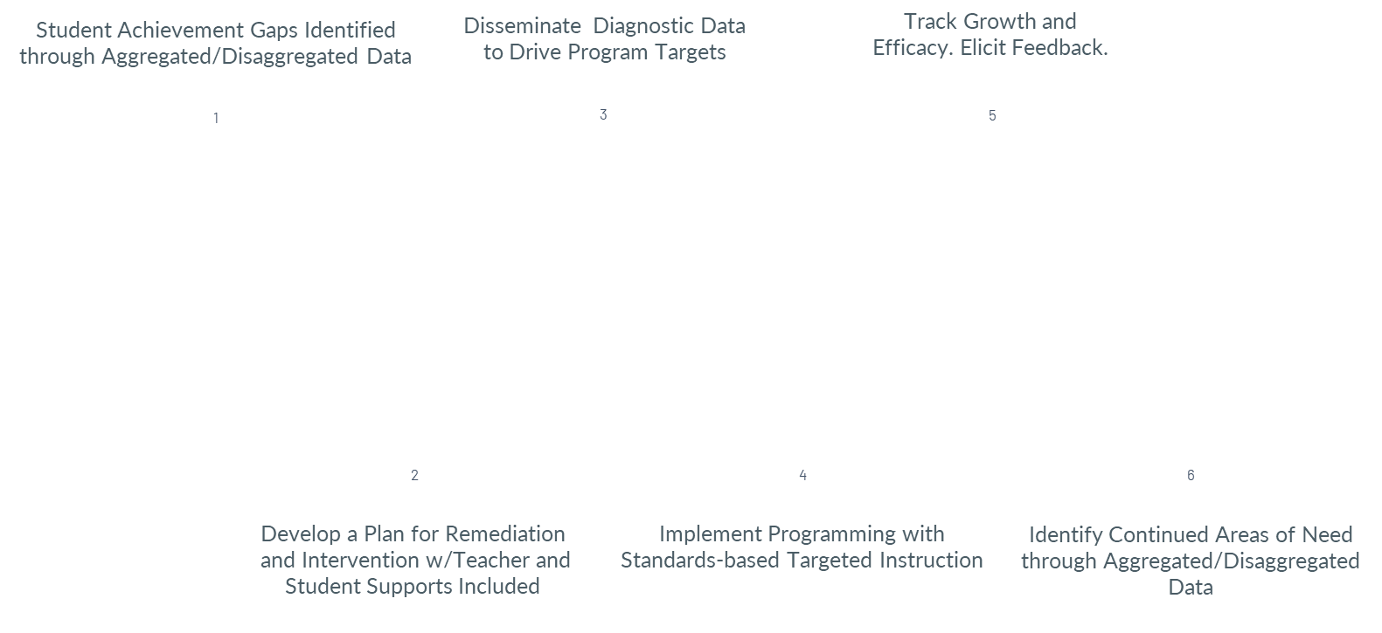
ROADMAP TO PROGRAMMING

Slide 19
THANK YOU!
Please contact the Office of Curriculum if you have any questions or wish to see sample documents.
srodriguez@navikings.org

Slide 20
Princeton Public School District
Notes:
Anthony

Slide 21
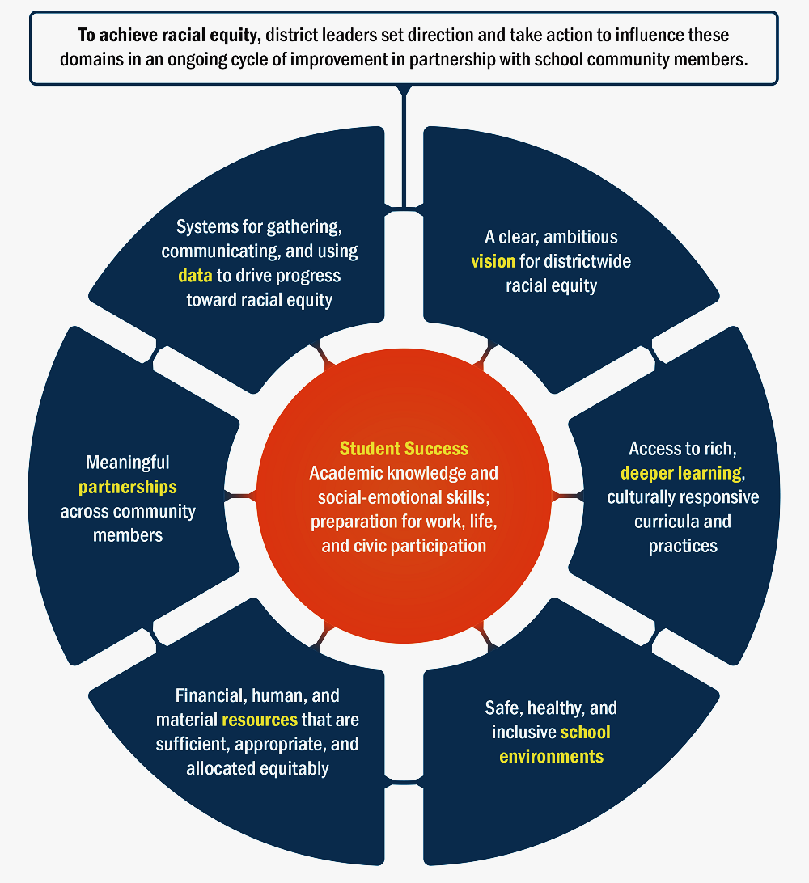
Determining Needs
PPS Began with Two Major initiatives that helped determine our needs:
District leadership, using the DARE Tool (Districts Advancing Racial Equity) as a guide engaged a wide variety of stake holders to determine priorities
District engaged in a comprehensive Special Education Program Review in partnership with the Public Consulting Group
Notes:
DARE tool helps to determine what is known about district actions that can support racial equity. The tool captures research-informed, high-leverage aspects of school that lead to systems that respond to the needs of students of color.
The Special Education Program Review was a comprehensive look at CST processes, disproportionality, Gen. Ed. Supports, I&RS, MTSS and special ed. programming

Slide 22
Our Needs Drive Our Commitments:
We commit to building professional processes, structures, and cultures that support personal well-being and provides opportunities for ongoing inquiry and critical reflections
We commit to building structures and resources that prioritize engagement and deeper learning
We commitment to community-building, routines and rituals that reduce stress, address trauma and promote healing and belong
We commit to the systematic use of a broad range of data to enhance equitable opportunity, experiences and success
Notes:
All data collected from these two major inquires resulted in the coalescing around 4 major themes – our commitments to our school community

Slide 23
Our Commitments Drive Our Goals
Critical Reflection and Inquiry
Student Engagement and Deeper Learning
Address Trauma and promote healing and belonging
Systemic Use of Data
Improve Our Learning Eco System
Address Impact of Remote Learning
Improve I&RS
Address Mental and Social Impact of Remote Learning
23
Notes:
With our commitments at the center of our decision making, ESSER/ARP provided opportunity to establish meaningful goals for this school year and beyond.

Slide 24
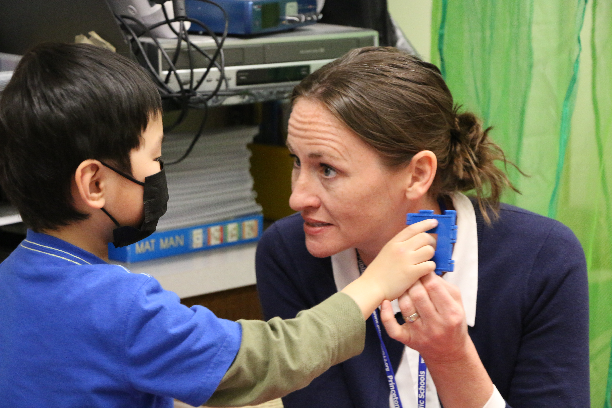
Our Goals Drive Our Actions
Goal 1: Improve our Learning Ecosystem
  Effective Co-Teaching to facilitate greater inclusion of students with disabilities
  A supportive, well scaffolded multi-tiered system of support
  Creation of an Early Childhood Articulation Summit
  Shift to Problem Based Learning
  Warehouse our data for easy access
Notes:
A learning Eco System is a collection of components that work together to create a whole learning experience. Healthy learning eco systems help districts withstand crises and generate long-term benefits for both educators and students. PPS, through critical inquiry, determined several components of our learning eco-system that needed improvement. ESSER/ARP provided us with the opportunity to restructure critical components associated with student success (inclusion, instructional and learning supports and meaningful articulation). This led to specific actions that are moving us towards our goal of a Healthy Learning Eco System.
Co-Teaching: We created a specific needs assessment and formed Collaborative Learning Communities around the idea of shared responsibility for students with disabilities
MTSS: PPS is fortunate to have plentiful resources. A diverse group of educators are using those resources to create a Princeton specific MTSS to address needs of all students
Early Childhood Summit: To get started on the right foot, Princeton is hosting all area PreK and K teachers to come together this summer to discuss all critical aspects of an early childhood program, understand the changes in eco systems as students moved up in grades and foster and environment of meaningful articulation that supports student transition without impact of personal bias.
LATIC Classrooms: PPS is working with the LATIC consultants to create problem-based learning classrooms that also address state learning standards but through complete engagement (“want to learn” not have to learn)
Work with LinkIT to provide easy access to student data allowing for better monitoring of how individual students are doing as well as sub groups overall. What gets measured, gets monitored

Slide 25
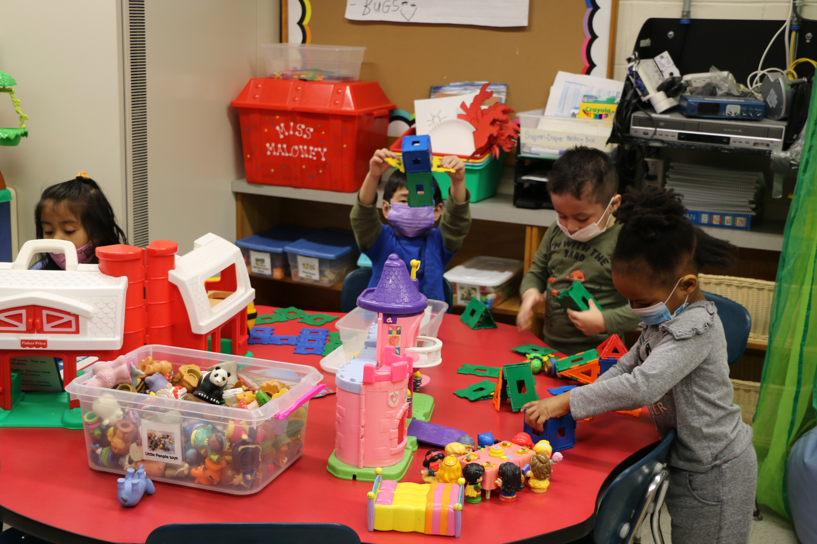
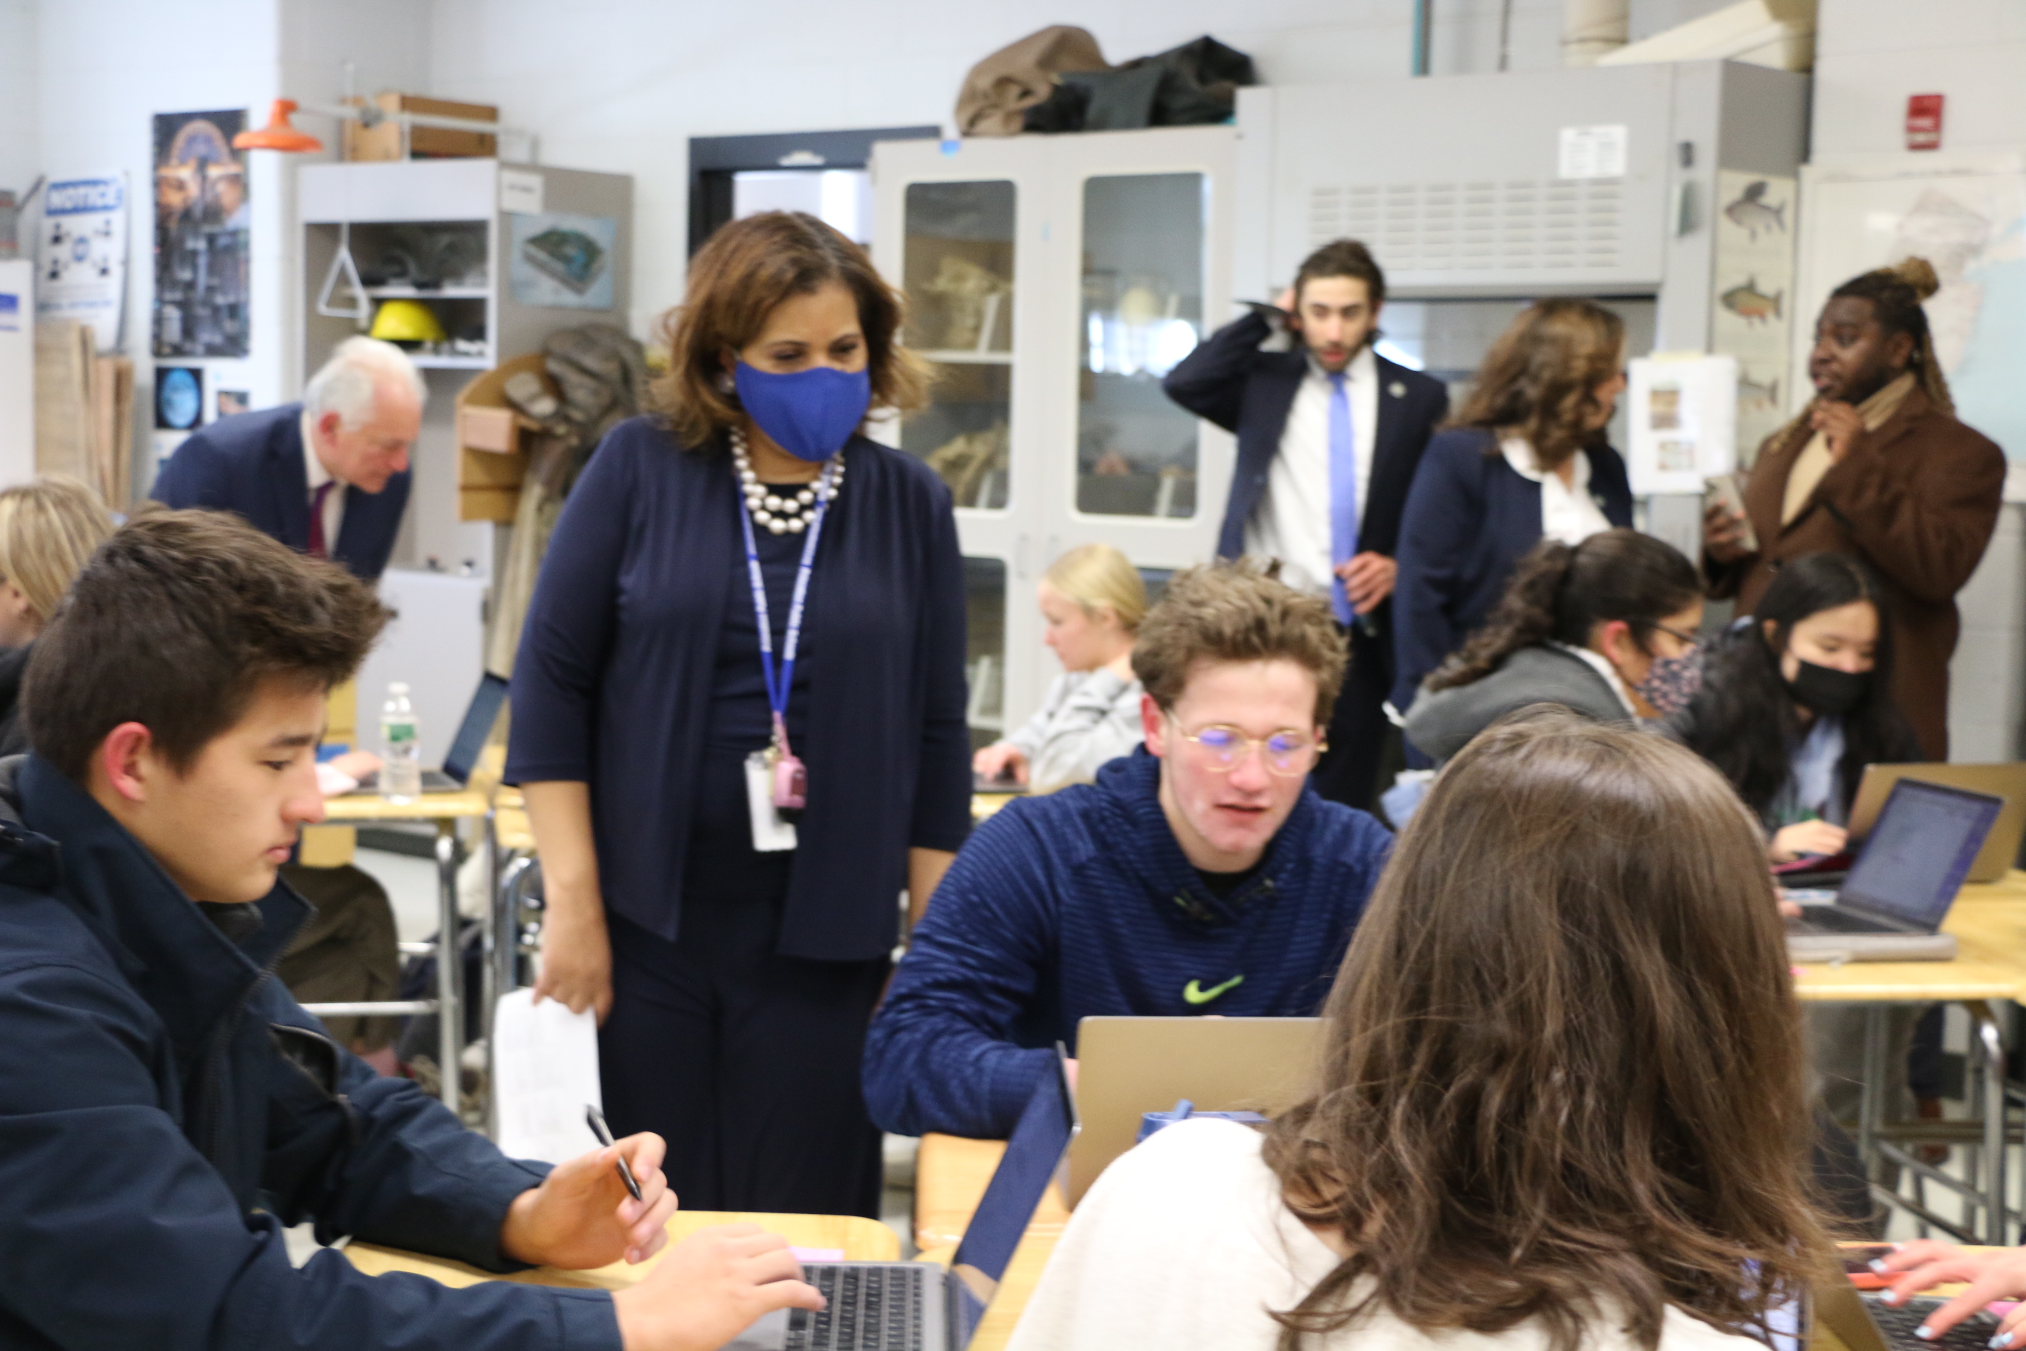
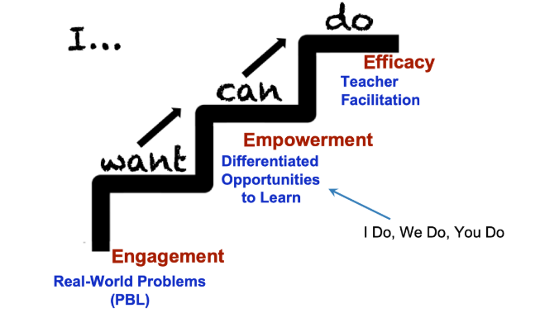
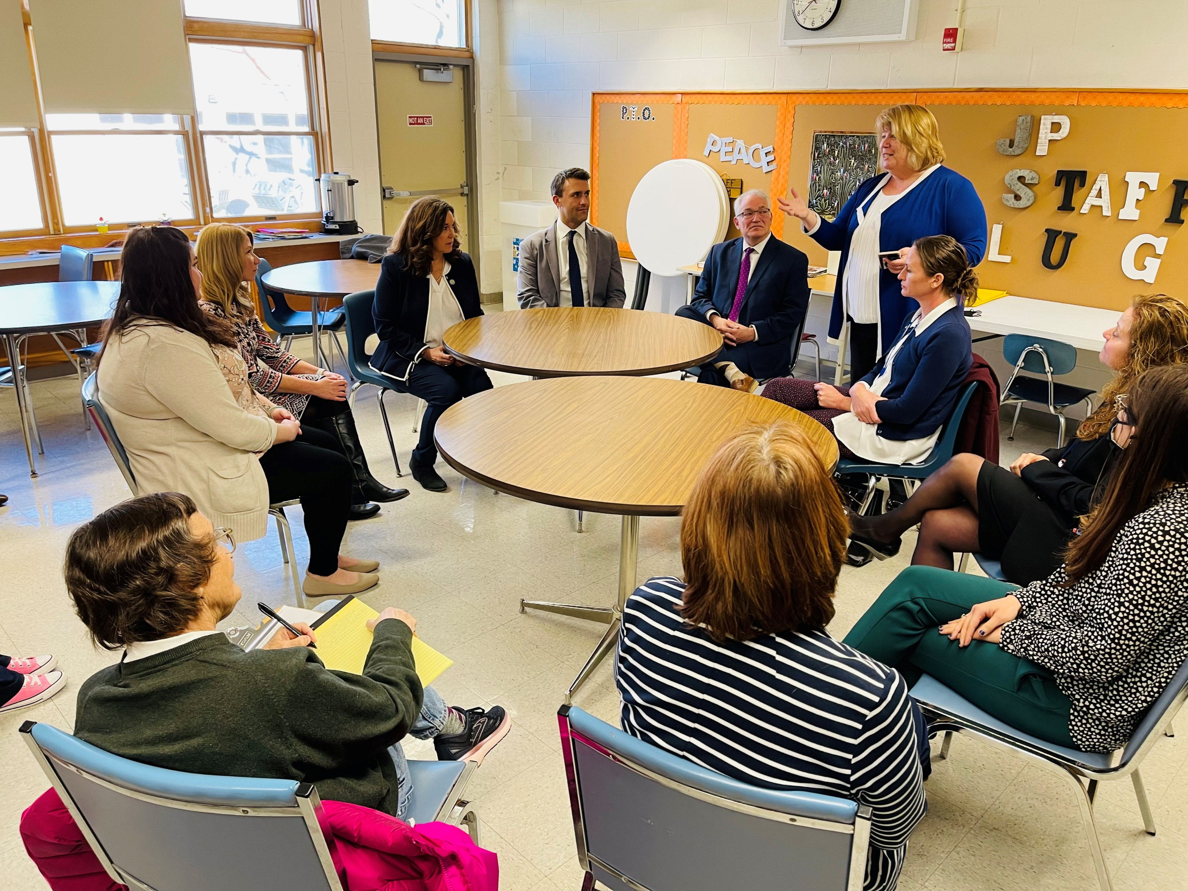
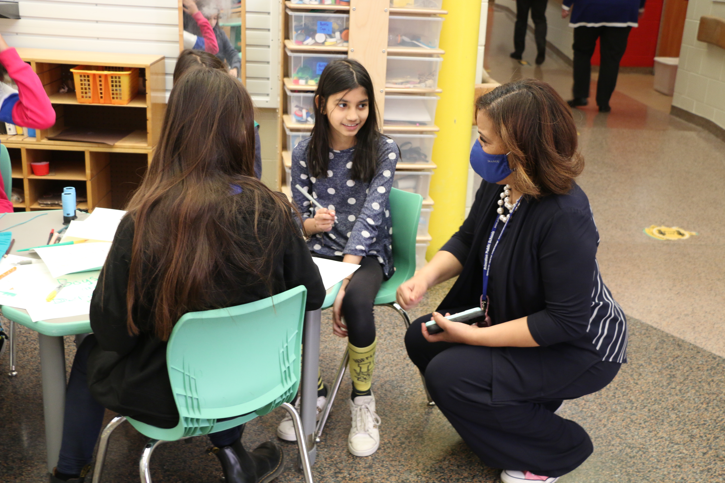
Engagement
Secondary: LATIC Classrooms
Early Childhood: Play-based learning
Teachers: Critical Reflection and data-based Inquiry
Meaningful inclusion for students of all abilities
Notes:
Focusing on Engagement is the critical component to all our projects. True engagement comes from real-world experiences and problems, motivates students and teachers to learn more and allows for facilitated learning over direct instruction. By focusing on process over product in early childhood, project-based experiences over lecture in high school and PLC and collaborative learning groups over delivered PD empowers our teachers and our students and creates the efficacy of our programs.

Slide 26
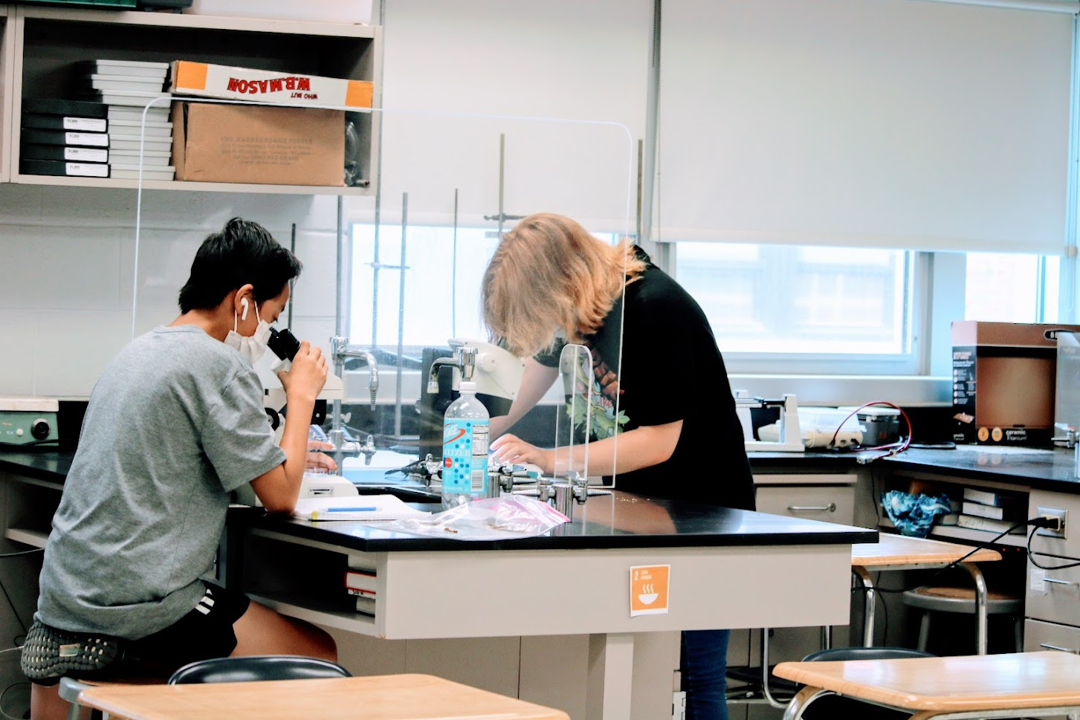

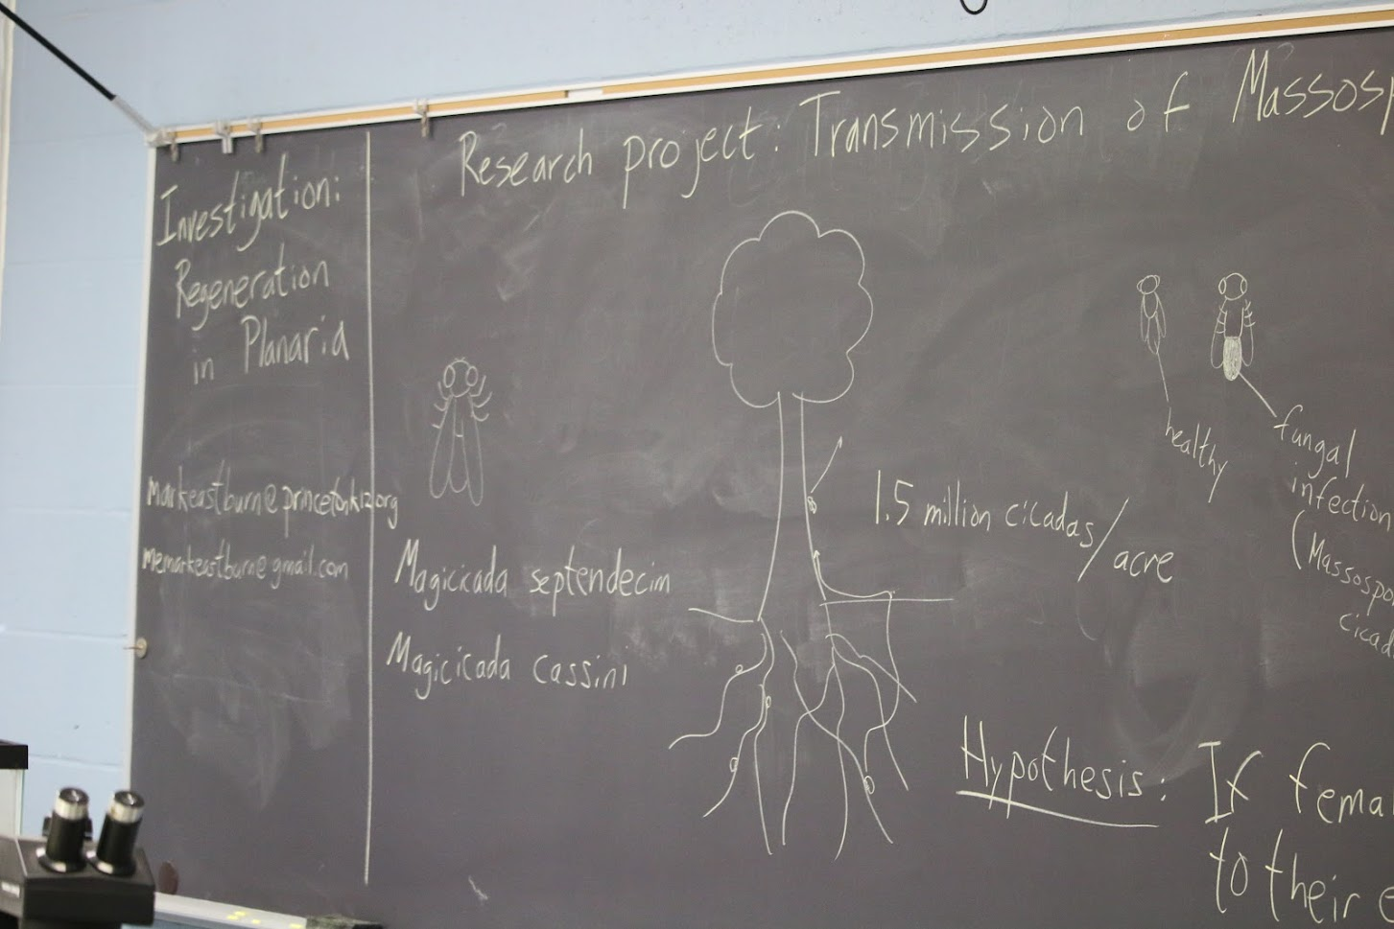

Goal 2: Address the Impact of Remote Instruction
  Summer Programs
  After School Support
  Saturday Academy
  Homework Help
  One to One Tutoring
Notes:
Summer Programs: Support – Jump Start, Tiger Camp and Educere Support
Enrichment – Bridge programs, Summer ELLs and LEAP
Acceleration – Science and Math
After School: Small Skill Groups at the elementary level to build reading and math foundation
Saturday Academy for credit recovery for High school students to get back on track towards graduation
Homework Help every day before and after school at PMS and PHS to improve executive functioning and improve grades (linked to college readiness)
One to One tutoring – Tier 3 support monitored by I&RS to accelerate learning

Slide 27

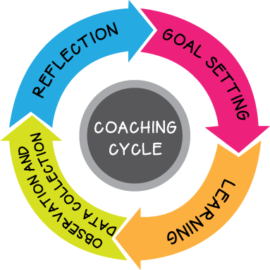

Goal 3: Address the Mental and Social Impact of Remote Instruction Through Expanded Supports
Notes:
Corner House and PFI provide clinical social workers to provide small group and individual therapies. Corner House specializes in adolescences and Alcohol and drug abuse and the PFI specializes in family counseling
Working with various behaviorists to create a program of reflective teacher coaching around Tier 1 and Tier 2 supports for elementary students
Our partnerships help to build a continuum of support for students from the classroom to school counselor to clinical counseling to outside intensive therapy

Slide 28



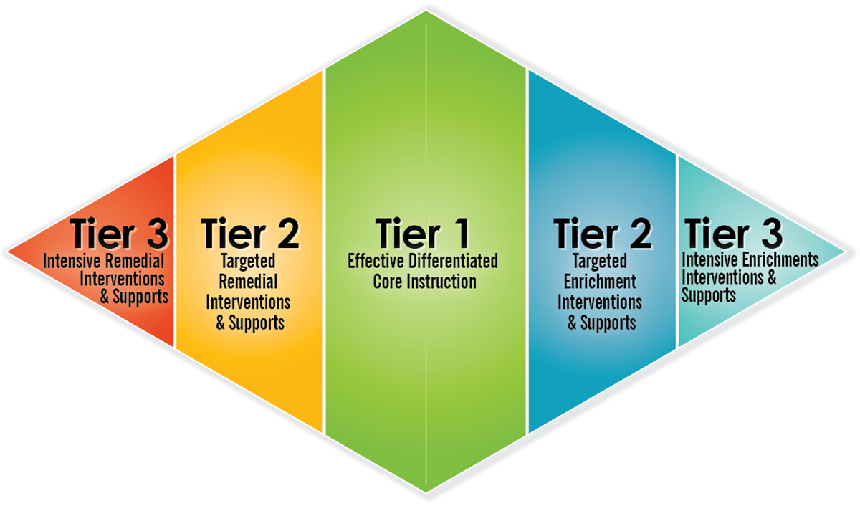


Goal 4: Improving I&RS
Notes:
PPS began with a comprehensive program review of our Intervention and Referral Services which led to an action plan that includes baseline training for all district teams, the development of a district I&RS manual to align practices among our schools and the further development of a MTSS including guidelines of how and when students move through Tiers. We are also moving to electronic method of housing and monitoring I&RS plans. All this work is funded through ESSER/ARP

Slide 29
Safe and Healthy Classrooms
Purchase of masks and see-through masks
Wages for lunch coverage to accommodate physical distancing
Purchase of additional tables and chairs for outdoor instruction
Wages for contact tracing
Installation of air purifiers and HEPA machines throughout the district
Purchase of bell covers for wind instruments
Purchase of goggles and sanitizing cabinets for all science labs
Purchase of Crisis Go symptom screener
Purchase of Owl Pro 360-degree cameras, mics and speakers

Slide 30
Cinnaminson Township Schools
Stephen M. Cappello, J.D., Superintendent
Frank Goulburn, Ed.D., Director of Curriculum
Notes:
Anthony

Slide 31
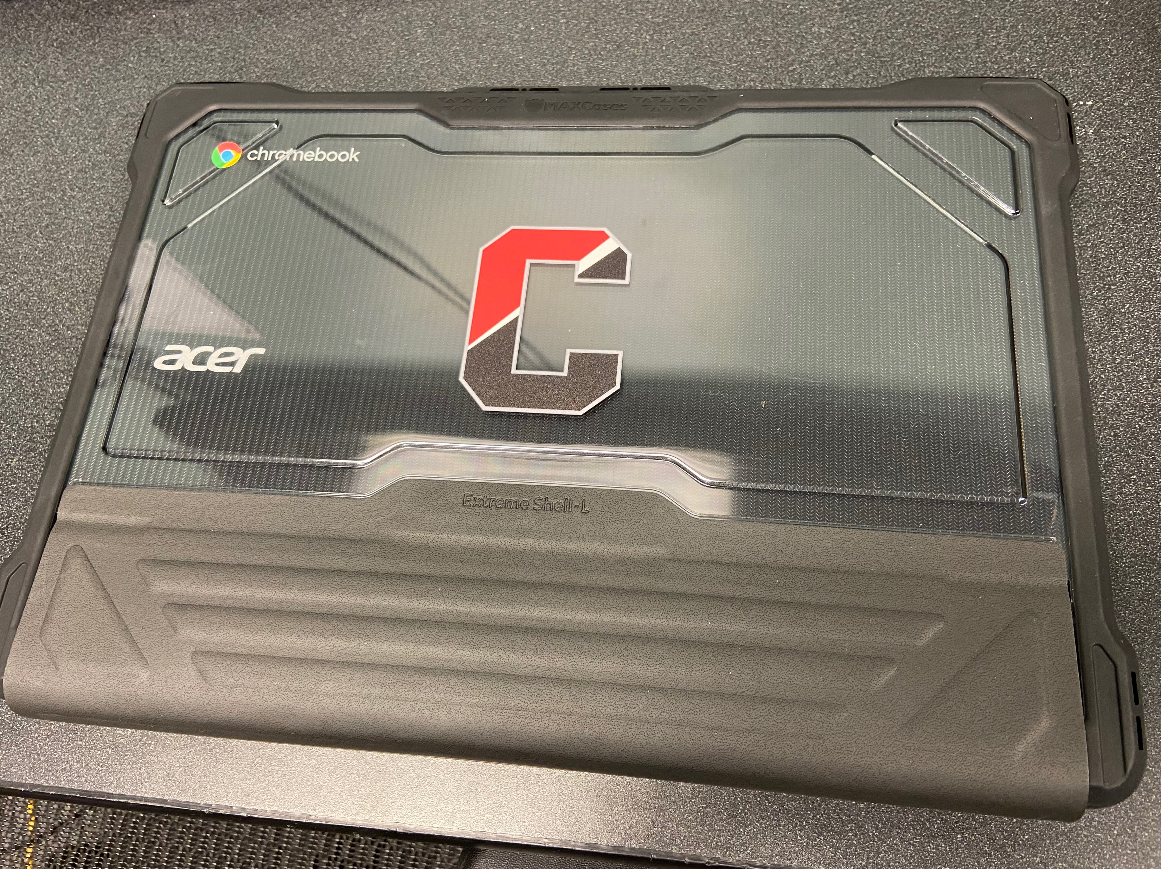
1:1 Chromebook Program
Coupled with ECF funding, our district utilized ARP ESSER funds to procure chromebooks for all students in grades 3-12
Program commenced in January 2022

Slide 32
Homebound Tutoring
CRRSA and ARP ESSER funds were dedicated to tutoring for students at risk of failure and for children on quarantine
Teachers (in all subjects) worked with children who were required to quarantine to catch up on missed work

Slide 33

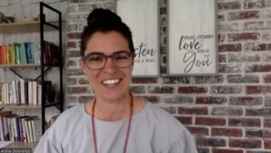

Professional Development
In-service speakers related to mental health and addressing learning gaps
On-site coaching for district math teachers
District wellness day for staff

Slide 34
Additional Counseling Staff
District hired two additional counselors (one K-5, one 6-12)
  Added support for existing staff
  Delivery of SEL lessons

Slide 35
Thank You!
New Jersey Department of Education Website
nj.gov/education
Questions may be submitted to:
ESSER@doe.nj.gov
Registration now open for the May 18, 2022, ARP ESSER Round Table
https://homeroom5.doe.state.nj.us/events/details.php?t=2;recid=39126
Follow Us!
Facebook:
@njdeptofed
Twitter: @NewJerseyDOE
Instagram:
@NewJerseyDoe
Notes:
Anthony

